Slide 1
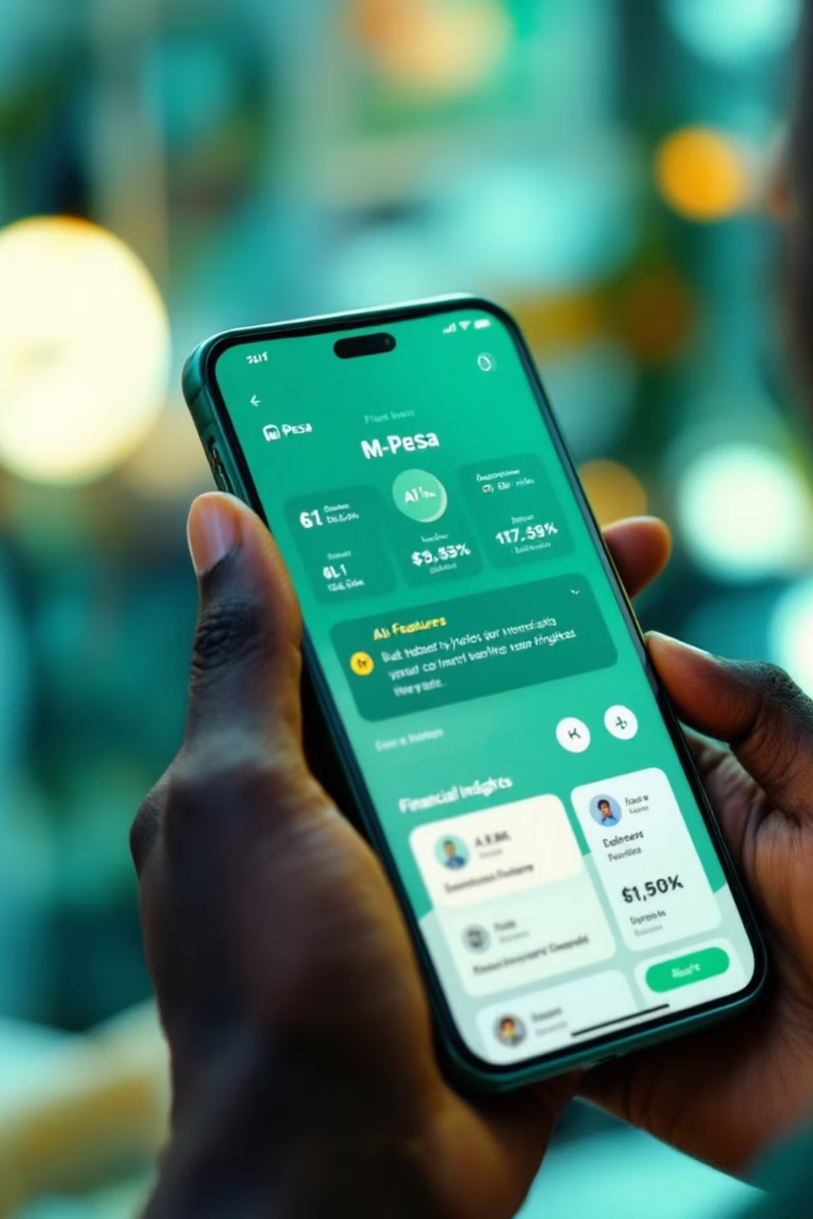
Revolutionizing Financial Management: The M-Pesa AI Agent

Slide 2
Revolutionizing Financial Management: The M-Pesa AI Agent
AFRICA AI WEEK LITERACY: NAIROBI TEAM
JENIPHER MAWIA
CAROLINE ALEXANDER
PHILLIP MACHAR
CAROLINE MWANGI
TRACY OTIENO

Slide 3

The Problem: Financial Literacy Gaps in Kenya
Despite M-Pesa's revolutionary impact on financial inclusion, many Kenyans still struggle with effective money management. These challenges persist despite high mobile money adoption, creating a critical gap between access and effective financial management.
73%
60%
Lack Basic Financial Skills
No Personal Budget
Most Kenyans do not possess fundamental financial literacy skills
The majority do not maintain any form of personal budget
82%
Financial Stress
Households experience stress due to unplanned spending
Most users have no visibility into spending patterns, and financial education remains inaccessible to the majority of the population.

Slide 4
Revolutionizing Financial Management: The M-Pesa AI Agent
Transform your financial journey with our innovative M-Pesa AI Assistant. This groundbreaking solution combines the trusted M-Pesa platform with advanced artificial intelligence to deliver personalized financial guidance, smart budgeting, and automated expense tracking—all while enhancing financial literacy for millions of Kenyans.
CA
Team Nairobi

Slide 5
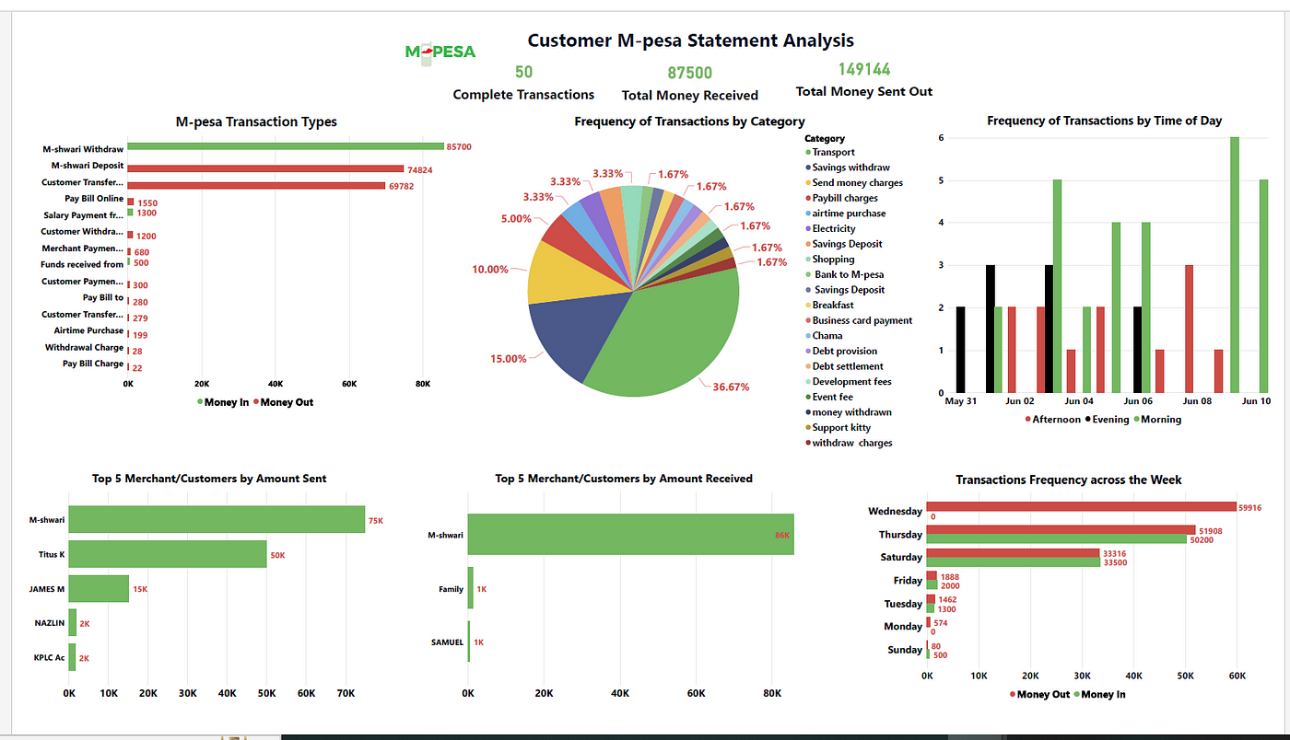
Introducing Our Solution: M-Pesa AI Assistant
Personalized Budget Creation
Real-Time Spending Alerts
Financial Goal Setting
AI analyzes transaction history and income patterns to recommend customized budget allocations across essential categories like food, transportation, and utilities.
Receive proactive notifications when approaching category limits or when unusual spending patterns are detected, helping prevent budget overruns.
Set savings targets for specific purposes (education, housing, emergencies) with AI-guided recommendations on achievable timeframes based on spending habits.

Slide 6
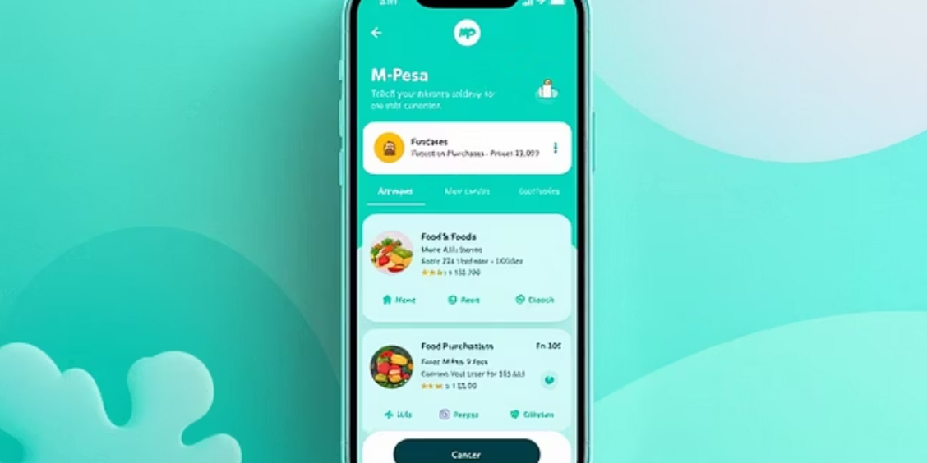
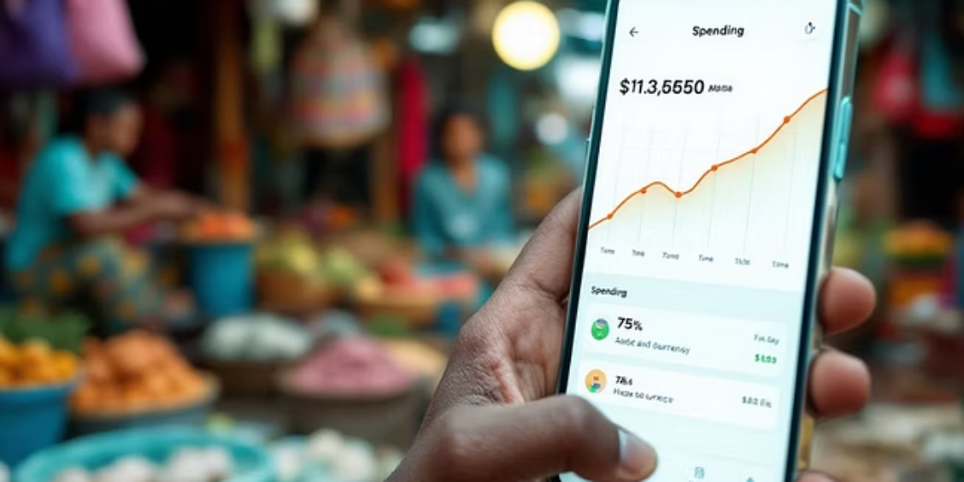




Smart Expense Tracking: Automatic Categorization & Analysis
Automated Purchase Categorization
Spending Pattern Insights
Recurring Payment Management
Discover your top spending categories and frequency patterns with visual analytics that reveal opportunities to optimize your budget and save money over time.
The ML model identifies and categorizes transactions based on user data and transaction patterns, eliminating manual entry and saving users valuable time.
Identify subscriptions and recurring payments automatically, with alerts for unusual increases and recommendations for potential savings on unnecessary expenses.

Slide 7





AI-Powered Intelligence: Behind the Scenes
1
2
Data Collection & Processing
Securely analyzes transaction history, merchant information, and spending patterns while maintaining strict privacy controls and user data ownership.
Gemini AI Analysis
3
Leverages Google's Gemini multimodal AI to recognize patterns, predict future spending, and generate personalized insights using natural language processing.
Personalized Recommendations
Delivers actionable financial advice tailored to individual circumstances, adapting recommendations as spending habits evolve and economic conditions change.
4
Secure Implementation
End-to-end encryption protects sensitive financial data, with on-device processing for sensitive information and anonymous learning models to ensure user privacy.

Slide 8

Implementation Roadmap: Integration with M-Pesa Infrastructure
Phase 1: Q3 2025
Launch core budgeting and expense tracking features integrated with existing M-Pesa app. Begin data collection for AI training with opt-in user participation.
Phase 2: Q4 2025
Introduce advanced pattern recognition and financial literacy modules. Roll out personalized recommendations and expand merchant categorization database.
Phase 3: Q1 2026
Deploy full Gemini AI capabilities with predictive budgeting and social learning features. Introduce API for third-party financial service integration.
Phase 4: Q2 2026
Scale solution across East Africa with localized financial literacy content. Launch small business features and enhanced financial planning tools.
Our strategic rollout plan ensures careful testing, refinement, and progressive feature expansion while maintaining robust security and user experience standards throughout implementation.

Slide 9

Expected Impact: Financial Empowerment and Economic Benefits
40%
8.5M
65%
Increased Savings
Users Reached
Reduced Stress
Projected average increase in personal savings rate for active users within the first year of adoption.
Estimated number of Kenyans who will benefit from enhanced financial literacy within 2 years of full implementation.
Projected decrease in financial anxiety among users as they gain control over spending and build financial resilience.
$430M
Economic Impact
Projected annual economic benefit through improved financial decision-making and increased savings across the Kenyan economy.
By democratizing financial intelligence, the M-Pesa AI Assistant will transform how Kenyans manage money, building a more financially resilient population and driving sustainable economic growth.

Slide 10






Future Implementation
Financial Literacy Integration: Learning Through Your Transactions
Learn While You Transact
Our AI assistant transforms everyday financial activities into learning opportunities:
Smart Tips
Savings Challenges
Bite-sized financial tips based on your specific transactions
Personalized savings challenges with achievement badges
Interactive Quizzes
Simple Explanations
Build knowledge while keeping you engaged
Easy-to-understand explanations of complex financial concepts
By embedding education into the daily M-Pesa experience, users develop financial skills without requiring separate learning sessions.
Community Features
Share financial goals and successes with peers

